Slide 1
FLOW STATE
An AI-powered daily check-in that connects
wellbeing, workload and planning
n8n • Google Calendar • OpenAI • Google Sheets • Gmail
AI for Good — Hackathon 2 | SDG 3: Good Health & Well-being
1

Slide 2
The problem
Busy days are planned around tasks — not around how someone is actually doing.
1. Fragmented information
2. No early signal
3. Generic advice
How you feel, what is in your calendar and your previous days live in different places.
People often notice overload only when they are already exhausted or behind.
A normal reminder does not know whether today is empty, packed, energetic or difficult.
Goal: turn a 1-minute check-in into useful, personalized guidance for the day.
2

Slide 3
Why SDG 3?
Good Health & Well-being — with a clear mental-health component
Mental well-being
Early awareness
Practical support
Flow State asks users to reflect on mood, energy and mental load instead of focusing only on productivity.
Combining a daily check-in with workload can help users notice when they may need to slow down, recover or seek support.
The AI turns the check-in into simple suggestions for pacing, breaks and planning — without diagnosing the user.
Flow State supports self-reflection and healthier day planning; it is not a medical tool.

Slide 4
The idea: Flow State
One simple daily flow, with as little manual work as possible.
1
2
3
4
Check in
Read calendar
AI review
Save & remind
Sleep, energy, mental load, mood + short note
Automatically checks today's scheduled hours
Combines today's input with recent historical data
Updates DailyData and sends the daily reminder
3

Slide 5
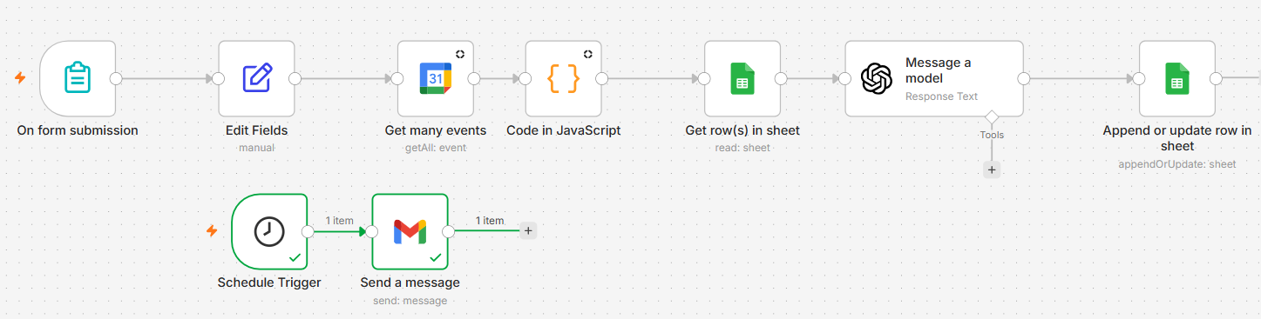
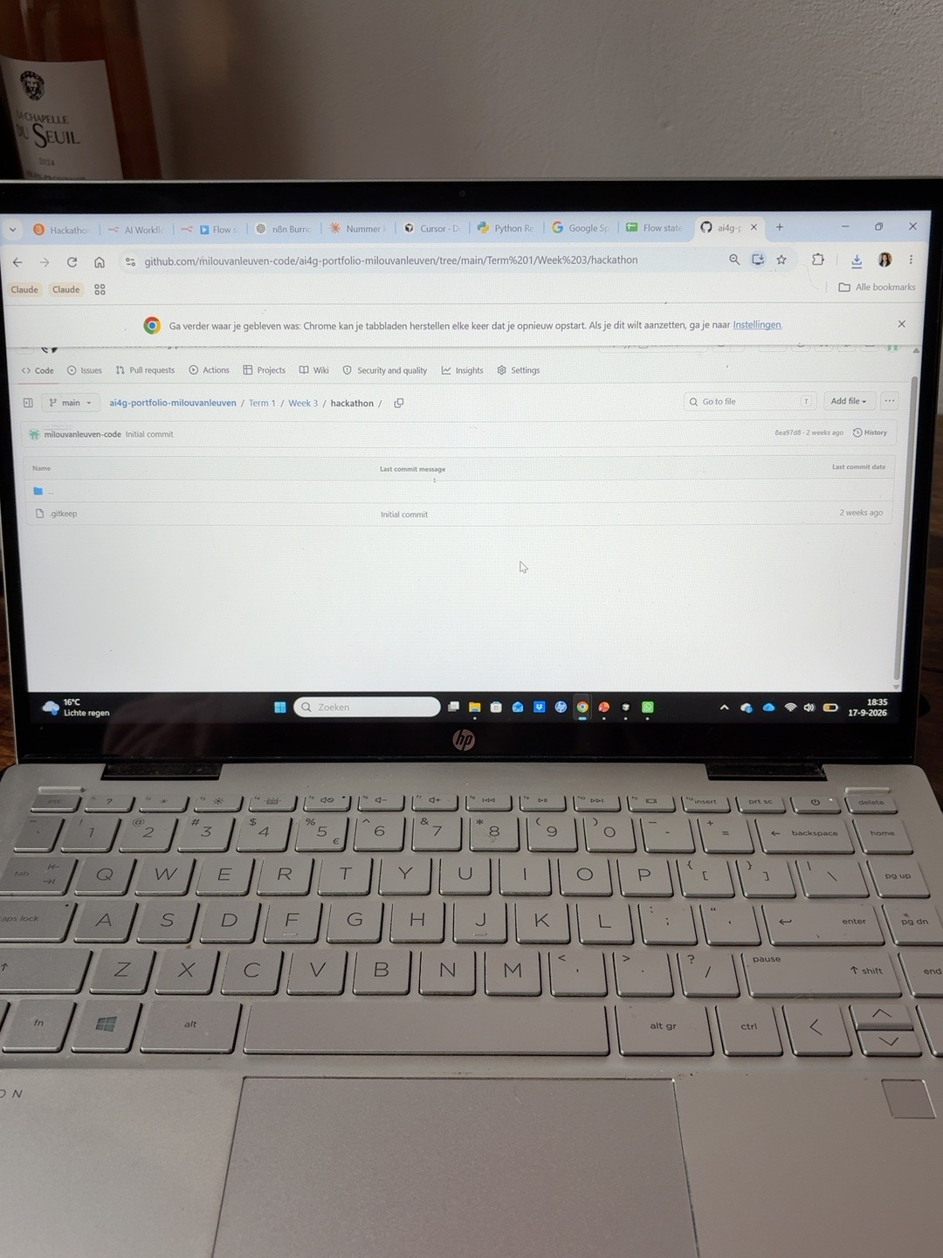
What I built in n8n
The prototype is a working automation, not just a mock-up.
• Form submission starts the main workflow
• Google Calendar provides today's workload
• JavaScript prepares the calendar data
• OpenAI creates a personalized daily review
• Google Sheets stores the result and history
• A separate Schedule Trigger sends the reminder email
✓ 6+ nodes ✓ AI ✓ automatic triggers
Demo: submit the form → show AI review → show updated Google Sheet / reminder email
4

Slide 6
What the AI actually does
It uses context instead of producing a generic wellness message.
Today's input
Output
Sleep • energy • mental load • mood • free-text note
1. Daily summary
2. What is going well
3. What to watch
4. Practical advice for today
AI REVIEW
Context
Calendar workload + previous DailyData entries
5

Slide 7
Example output
The result is immediately understandable and actionable.
“You slept 7 hours and reported a good mood. Your calendar is relatively open today, so you have flexibility. Because you still feel tired, start with one small clear task, take an early restorative break and reassess your energy.”
Important: Flow State is a planning & self-reflection tool — not a medical diagnosis system.
6

Slide 8
Why this is useful
The value comes from connecting data that normally stays separate.
Low effort
Personalized
Learns over time
One short form. The calendar lookup, analysis, storage and reminder are automated.
Advice changes with both subjective input and objective workload.
DailyData creates a history that can later reveal patterns and support better planning.
Future step: a dashboard with weekly trends, overload signals and smarter reminders.
7

Slide 9
Ethical reflection
Health automation must have clear limits.
If it is wrong
If it is late or down
Where AI stops
Privacy & trust
AI can misread mood, sleep or workload and give unsuitable advice. Output should be framed as support, never as diagnosis.
n8n, Gmail, Calendar or the AI service can fail. Flow State must never be relied on for urgent or safety-critical help.
Persistent or serious mental-health concerns require human judgement and, where appropriate, professional support.
Sleep, mood, notes and calendar data are personal. Users should know what is accessed and retain control over their data.
Would we trust it? Yes — as a self-reflection and planning assistant. No — as a replacement for a doctor, psychologist or emergency service.

Slide 10
FLOW STATE
From a 1-minute check-in
to a smarter plan for your day.
Questions?
8

